Slide 1

Understanding Apache Spark: Fundamentals, Architecture, and Comparative Analysis
Exploring the core principles of Apache Spark
Notes:
--- Apache Spark is an open-source distributed computing system that provides an interface for programming entire clusters with implicit data parallelism and fault tolerance. In this presentation, we will explore the fundamentals, architecture, benefits, and a comparative analysis with other frameworks.

Slide 2
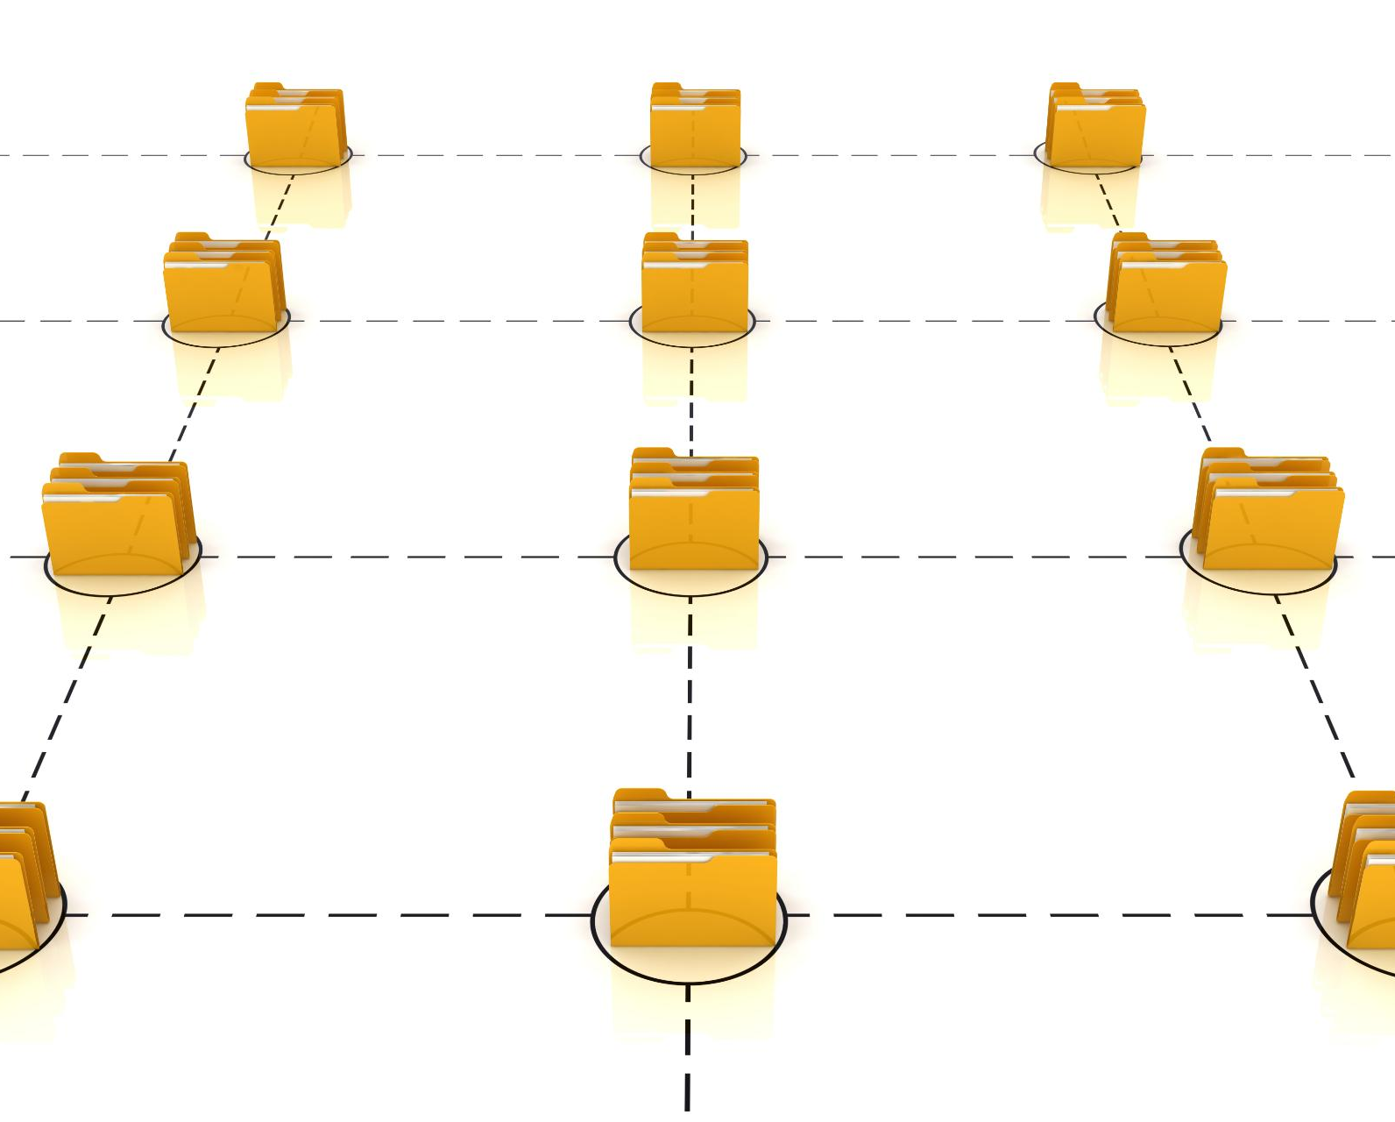
Agenda for Apache Spark Presentation
Fundamentals of Apache Spark
Spark Architecture
Primary Components of Spark
Benefits of Using Spark
Spark vs MapReduce vs Hadoop
Setting Up Apache Spark
Notes:
This presentation will cover various aspects of Apache Spark, including its fundamentals, architectural components, primary features, benefits, and how it compares to other data processing frameworks like MapReduce and Hadoop. We will also provide a guide on setting up Apache Spark.

Slide 3
Fundamentals of Apache Spark
Notes:
To understand Apache Spark, we will begin with its fundamental concepts, including its purpose and capabilities in big data processing. It is vital to grasp what makes Spark a popular choice among data engineers.

Slide 4

Introduction to Apache Spark
Fast Data Processing
Apache Spark is built for speed, enabling quick processing of large data sets across various platforms.
General-Purpose Framework
Spark serves as a general-purpose framework that supports a variety of data processing tasks like batch and stream processing.
Multi-Language Support
It provides APIs in Java, Scala, Python, and R, making it accessible for various programming communities.
Notes:
Apache Spark is designed to be fast and general-purpose. It provides APIs in Java, Scala, Python, and R, enabling users to perform data processing tasks efficiently across various data sources.

Slide 5
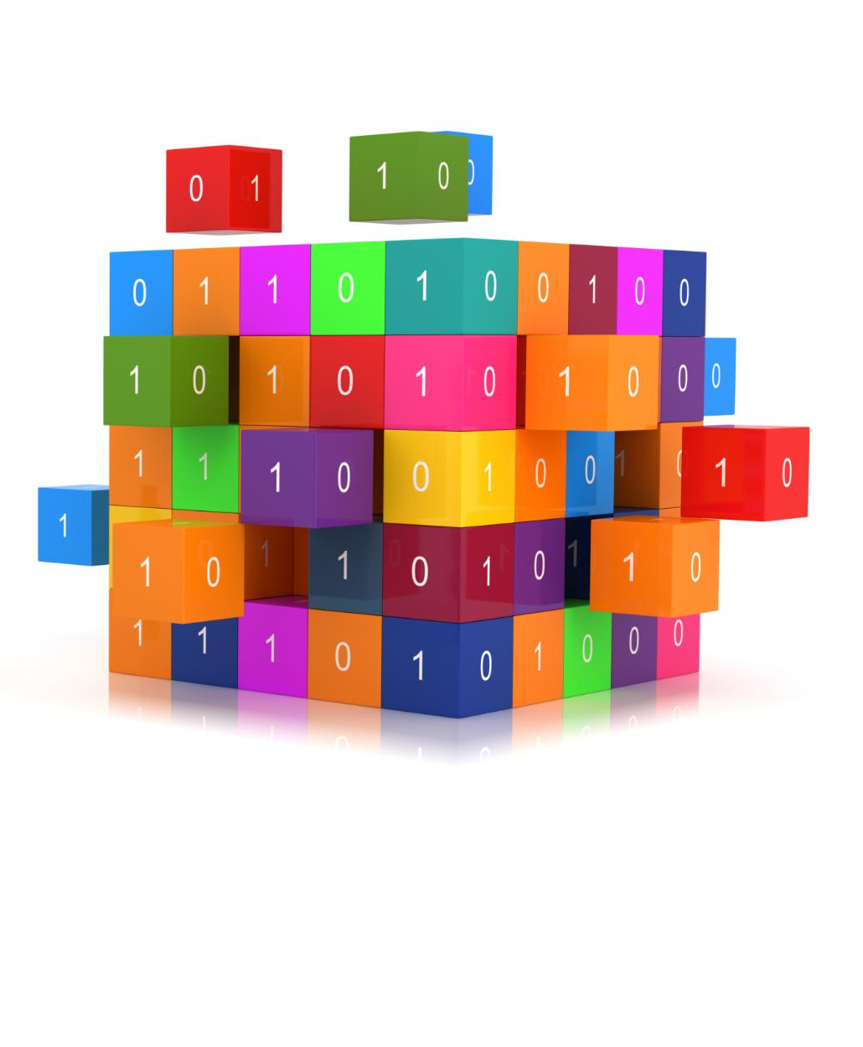
Key Features and Capabilities
In-Memory Data Processing
Apache Spark's in-memory data processing allows for faster data access and computations, significantly improving performance for big data tasks.
Fault Tolerance
Spark provides built-in fault tolerance, ensuring that data is not lost and tasks can recover from failures efficiently.
Ease of Integration
The platform easily integrates with various data sources such as Hadoop, SQL databases, and cloud storage, enhancing its versatility.
Notes:
Some of the key features of Apache Spark include in-memory data processing, fault tolerance, and ease of integration with various data sources. These features make it highly efficient for big data tasks.

Slide 6

Understanding RDDs (Resilient Distributed Datasets)
Fundamental Building Blocks
RDDs serve as the core abstraction for processing data in Apache Spark, enabling efficient parallel processing.
Parallel Data Processing
RDDs allow data to be processed in parallel across a cluster, significantly improving computation speed and efficiency.
Fault Tolerance
One of the key features of RDDs is fault tolerance, allowing systems to recover from failures automatically.
Automatic Data Distribution
RDDs handle automatic data distribution across nodes in a cluster, simplifying the management of distributed data.
Notes:
RDDs are the fundamental building blocks of Apache Spark. They provide an abstraction for data that can be processed in parallel across a cluster, enabling fault tolerance and automatic data distribution.

Slide 7
Spark Architecture
Notes:
The architecture of Apache Spark is crucial for understanding how it processes data. We will now examine its core components and the execution model that facilitates data operations.

Slide 8
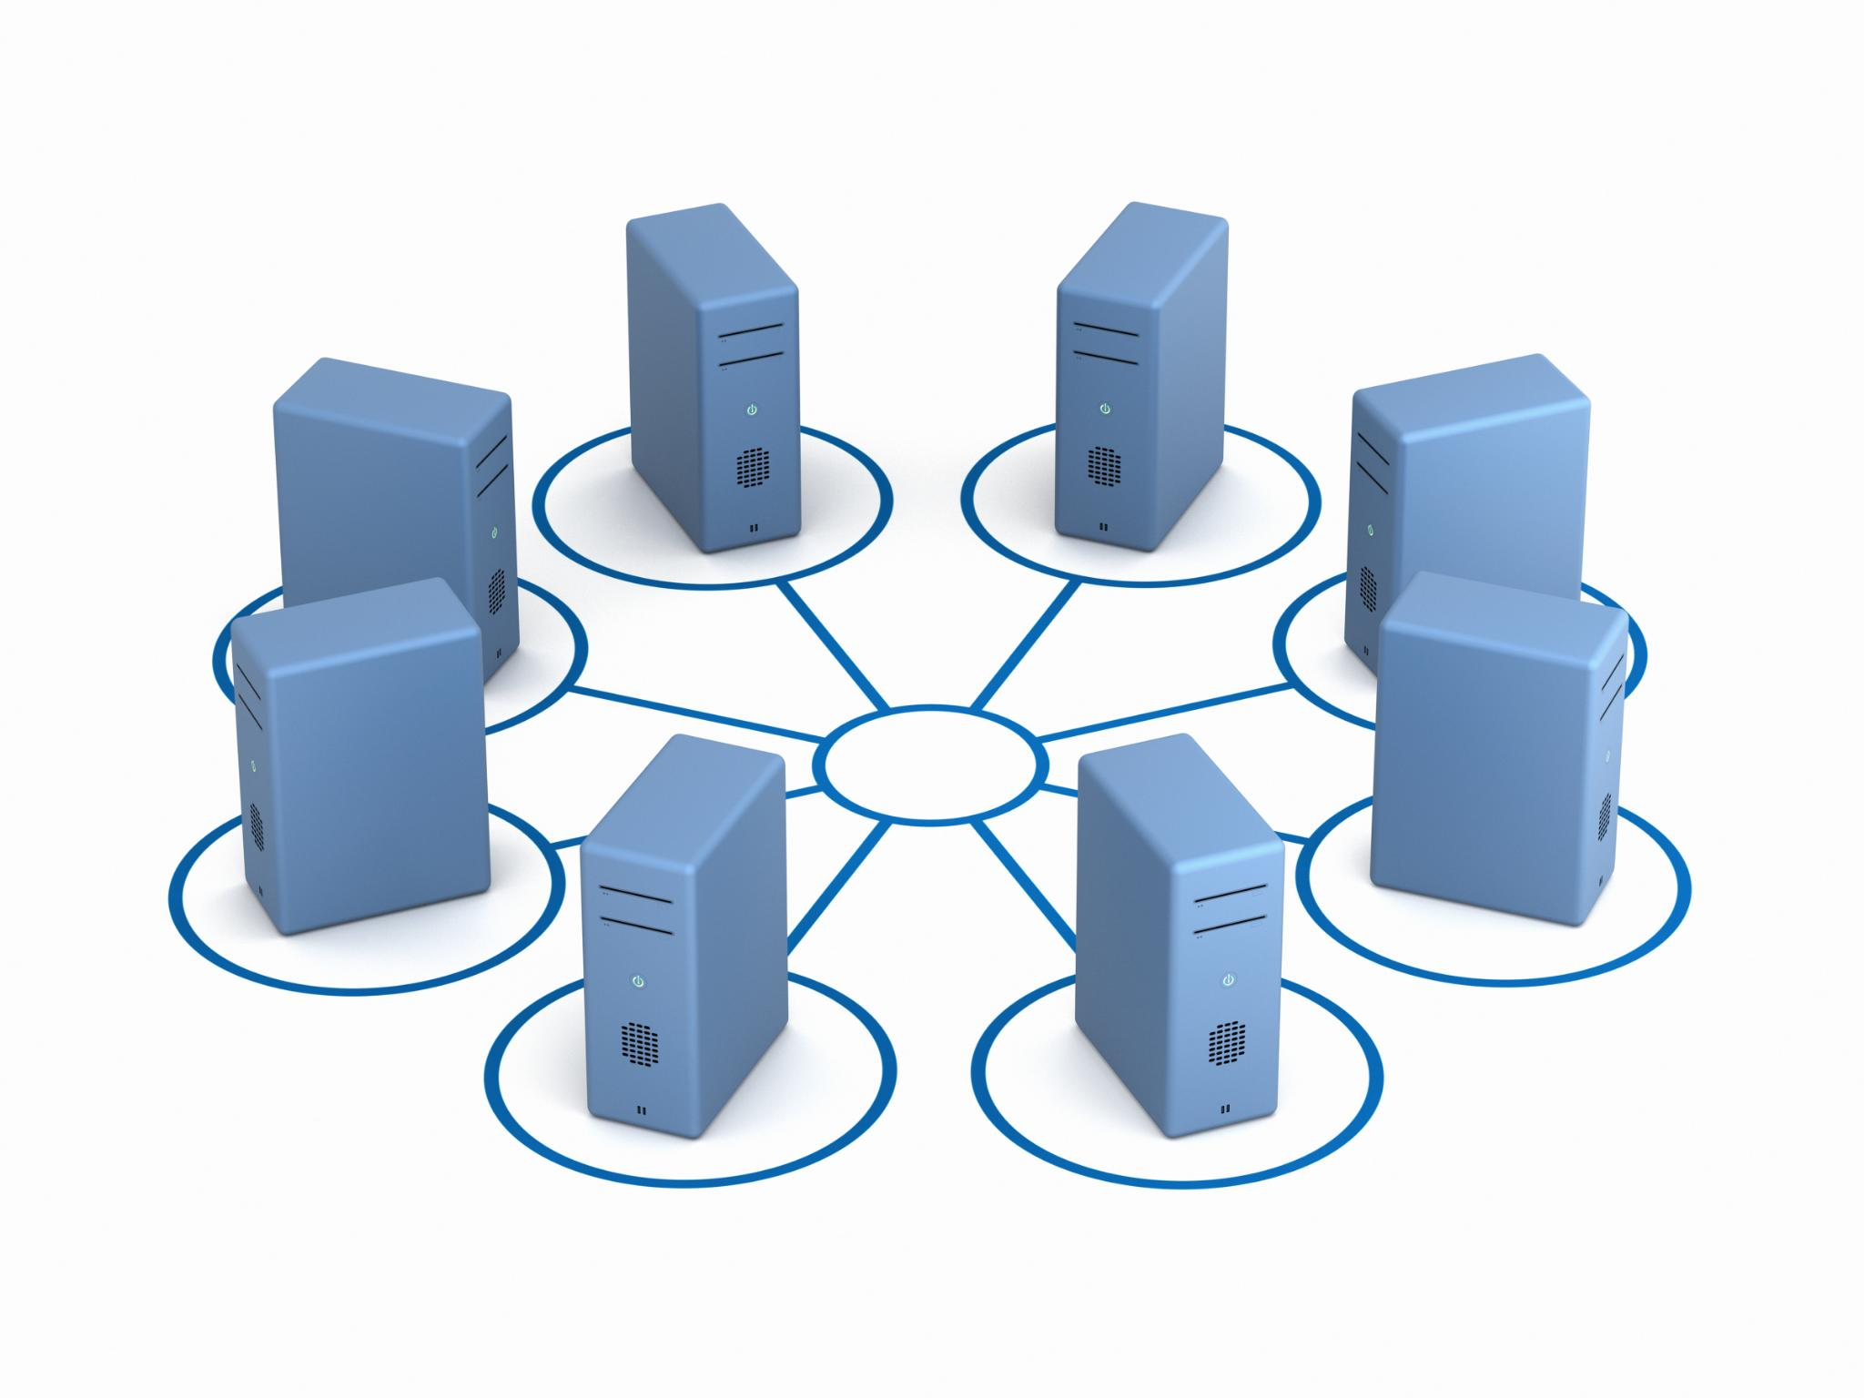
Core Components of Spark Architecture
Driver Component
The Driver is the master process that orchestrates the entire Spark application, managing the execution of tasks and resource allocation.
Cluster Manager
The Cluster Manager is responsible for managing the resources across the cluster, allocating them to various applications and ensuring efficient execution.
Executors
Executors are worker nodes that execute tasks and store data for the Spark application, playing a crucial role in parallel processing.
Notes:
Spark's architecture includes several core components, such as the Driver, Cluster Manager, and Executors. Each plays a vital role in managing resources and executing tasks across the cluster.

Slide 9
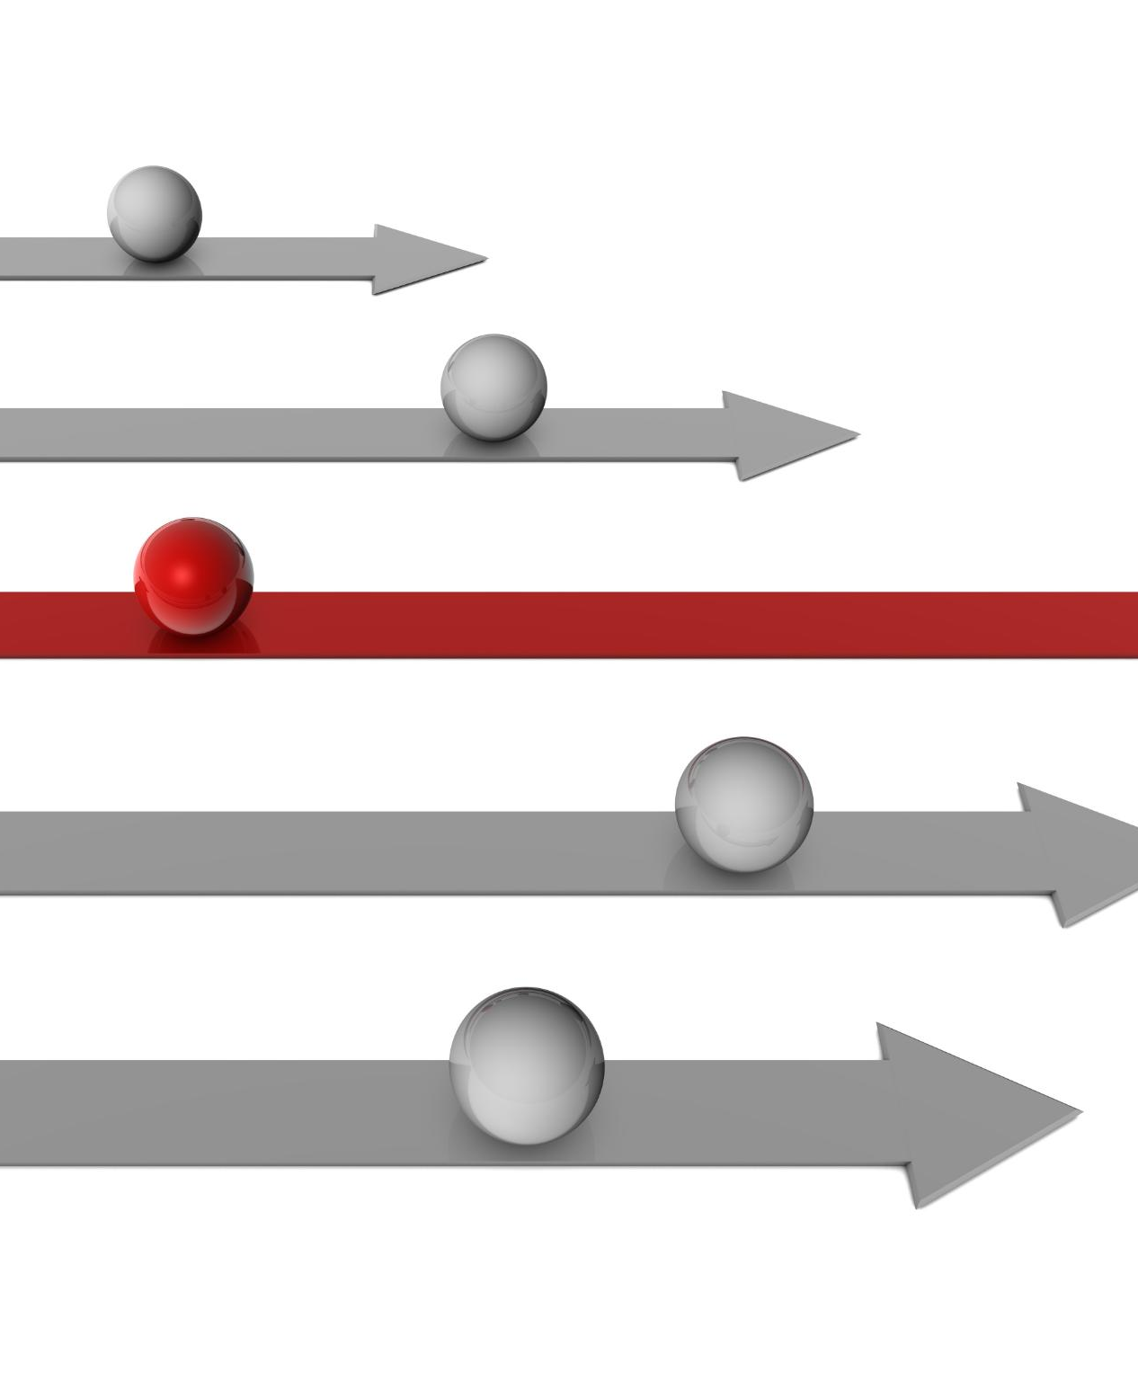
Details of the Spark Execution Model
Efficiency and Speed
The Spark execution model emphasizes efficiency and speed by optimizing how tasks are processed.
Task Division
Tasks in Spark are divided into stages, allowing for organized and manageable execution.
Parallel Execution
By executing tasks in parallel, Spark maximizes resource utilization, leading to faster processing times.
Notes:
The Spark execution model is designed for efficiency and speed. It divides tasks into stages and executes them in parallel, which maximizes resource utilization and reduces processing time.

Slide 10

Role of Spark Driver and Executors
Spark Driver Function
The Spark Driver is responsible for orchestrating the execution of tasks across the cluster, ensuring efficient operation.
Executors' Responsibility
Executors are responsible for running the assigned tasks and returning the results to the Driver, enabling distributed processing.
Resource Management
This separation of roles allows for efficient management of resources, optimizing performance in a distributed computing environment.
Notes:
The Spark Driver orchestrates the execution of tasks, while Executors are responsible for running the tasks and returning results. This separation allows for efficient management of resources in a distributed environment.

Slide 11
Primary Components of Spark
Notes:
Apache Spark consists of several components that enhance its data processing capabilities. We will explore these primary components that cater to different data processing requirements.

Slide 12

Spark Core
Foundation of Spark Framework
Spark Core serves as the backbone of the Spark framework, enabling efficient data processing and analytics.
Task Scheduling
It provides essential functionalities for task scheduling, ensuring optimal resource utilization and performance in data processing.
Memory Management
Efficient memory management within Spark Core enhances performance and allows for handling large datasets effectively.
Fault Recovery
Spark Core features built-in fault recovery mechanisms to ensure reliability and continuity during data processing tasks.
Notes:
Spark Core is the foundation of the Spark framework, providing essential functionalities such as task scheduling, memory management, fault recovery, and interaction with storage systems.

Slide 13

Spark SQL
Structured Data Module
Spark SQL is designed for processing structured data efficiently within the Spark ecosystem, enabling effective data management.
SQL Queries Integration
It allows users to run SQL queries directly on data, combining traditional database capabilities with big data processing.
DataFrames and Datasets
Users can leverage DataFrames and Datasets for optimized data processing, making analytics more powerful and efficient.
Notes:
Spark SQL is a module for working with structured data. It enables users to run SQL queries alongside data processing using DataFrames and Datasets, offering a powerful tool for data analytics.

Slide 14

Spark Streaming
Real-Time Data Processing
Spark Streaming enables real-time data processing, allowing applications to handle data as it arrives instantly.
Integration with Spark Core
Seamless integration with Spark Core enhances its capabilities for real-time data applications, making it a powerful tool for developers.
Building Streaming Applications
Developers can create applications that process live data streams, facilitating timely decision-making and insights.
Notes:
Spark Streaming allows for real-time data processing. It integrates seamlessly with Spark Core and enables developers to build applications that can process live data streams.

Slide 15
Benefits of Using Spark
Notes:
Apache Spark offers numerous benefits that make it a preferred choice for data processing. We will now look at the advantages that set Spark apart from other frameworks.

Slide 16
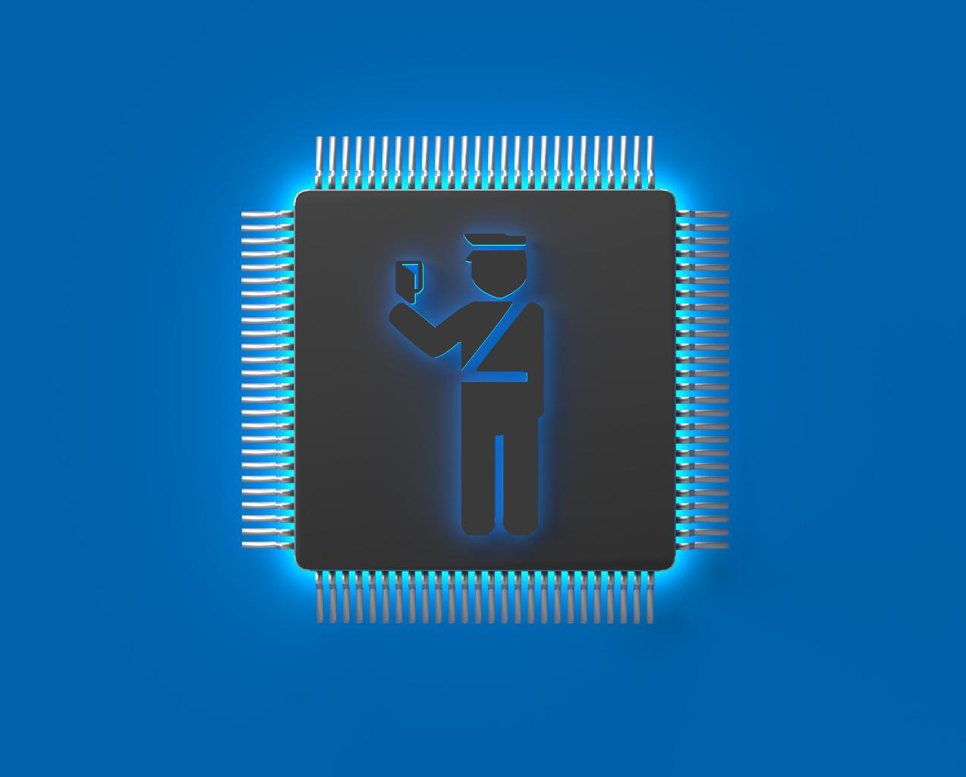
Speed and Performance Advantages
In-Memory Processing
In-memory processing allows Spark to access data directly from memory, which greatly speeds up data retrieval and computation.
Performance Over Traditional Frameworks
Spark's architecture outperforms traditional disk-based systems, leading to faster execution times for data processing tasks.
Notes:
One of the primary benefits of Spark is its speed. By utilizing in-memory processing, Spark can outperform traditional disk-based processing frameworks, significantly reducing execution times.

Slide 17

Ease of Use and APIs
User-Friendly APIs
Spark offers user-friendly APIs in multiple programming languages, catering to a wide range of developers.
Enhanced Productivity
The simplicity of Spark's APIs enables users to write code quickly and efficiently, leading to increased productivity.
Notes:
Spark provides user-friendly APIs in various languages, making it accessible for developers. Its simplicity allows users to write code quickly and efficiently, enhancing productivity.

Slide 18

Versatility and Unified Processing Engine
Batch Processing
Spark efficiently manages batch processing, enabling high-speed data analysis on large datasets using its powerful framework.
Streaming Data
With Spark, real-time data streaming is seamlessly integrated, allowing for instant data processing and analysis as it arrives.
Machine Learning
Spark includes robust machine learning capabilities, empowering users to build and deploy predictive models at scale.
Graph Processing
Spark's unified framework supports graph processing, allowing complex data relationships to be analyzed effectively.
Notes:
Spark's versatility allows it to handle batch processing, streaming data, machine learning, and graph processing all within a single framework, providing a unified solution for diverse workloads.

Slide 19
Spark vs MapReduce vs Hadoop
Notes:
In this section, we will conduct a comparative analysis of Apache Spark with MapReduce and Hadoop to highlight their differences and use cases.

Slide 20
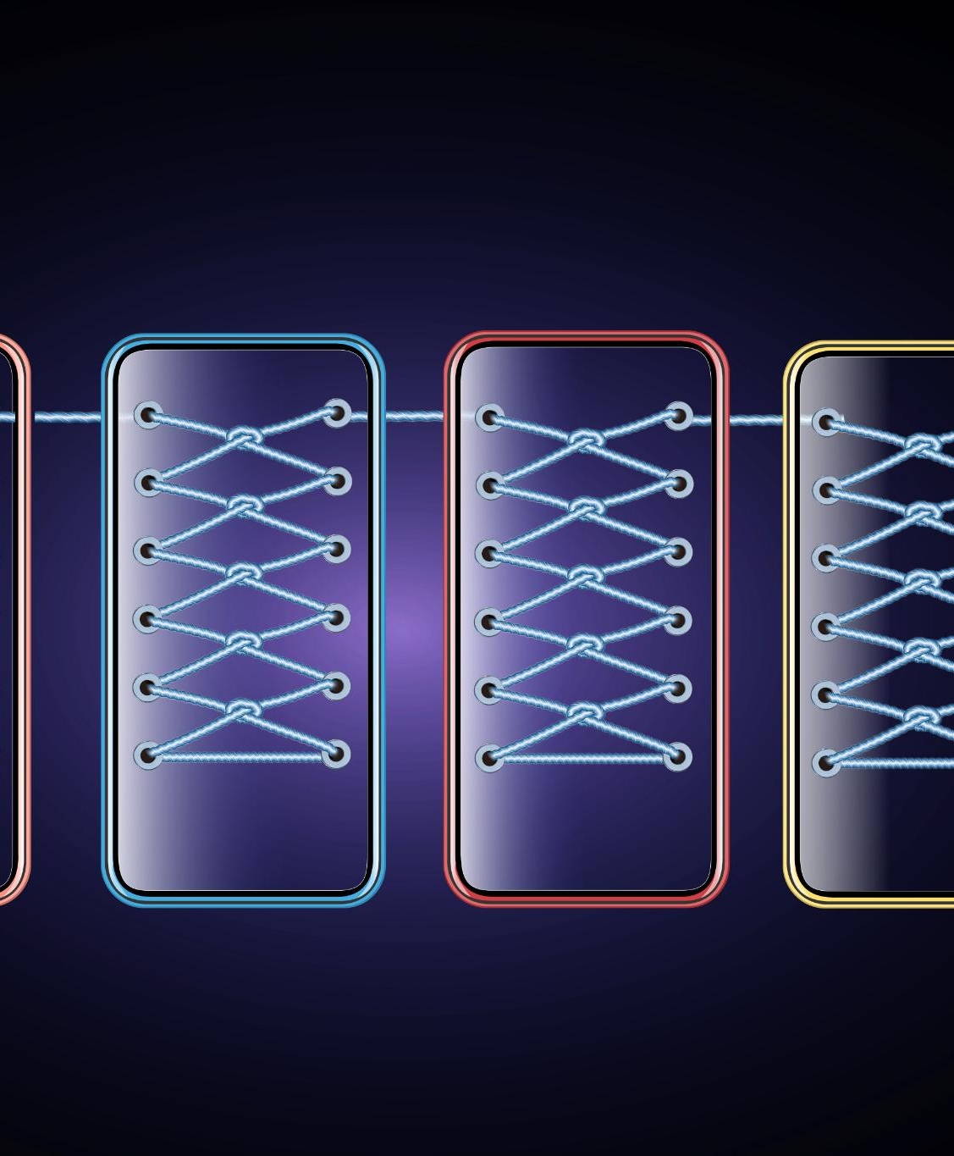
Comparative Analysis of Spark and MapReduce
Speed of Processing
Spark's in-memory processing allows for significantly faster data processing compared to MapReduce's disk-based storage approach.
Ease of Use
Spark provides a more user-friendly API and higher-level abstractions than MapReduce, making it easier for developers to use.
Data Processing Approaches
Spark's in-memory processing contrasts with MapReduce's reliance on multiple disk I/O operations, affecting overall performance.
Notes:
Spark and MapReduce serve similar purposes in big data processing but differ significantly in speed and ease of use. Spark’s in-memory processing makes it faster, while MapReduce relies on disk-based storage.

Slide 21

Differences Between Spark and Hadoop
Hadoop as Storage System
Hadoop is primarily designed as a distributed storage system, enabling large-scale data storage across multiple nodes.
Spark as Processing Engine
Spark functions as a fast processing engine, allowing for real-time data processing and analytics on large datasets.
Use Case Scenarios
The differences in design lead to varying use case scenarios, with Hadoop suited for batch processing and Spark for real-time analytics.
Notes:
While both frameworks are used for big data processing, Hadoop is primarily a storage system, whereas Spark is a processing engine. This distinction leads to different use case scenarios and performance characteristics.

Slide 22

Use Cases and Scenarios for Each Framework
Spark for Real-Time Analytics
Spark excels in scenarios requiring real-time data processing and analytics, making it ideal for time-sensitive applications.
Hadoop for Batch Processing
Hadoop is designed for processing large datasets in batch mode, making it suitable for long-term data analysis and storage.
Notes:
Each framework has its strengths and is suited for different scenarios. Spark is ideal for real-time analytics and iterative algorithms, while Hadoop is better for batch processing of large datasets.

Slide 23
Setting Up Apache Spark
Notes:
To leverage the power of Apache Spark, setting it up correctly is essential. We will discuss prerequisites and provide a step-by-step guide for installation and configuration.

Slide 24
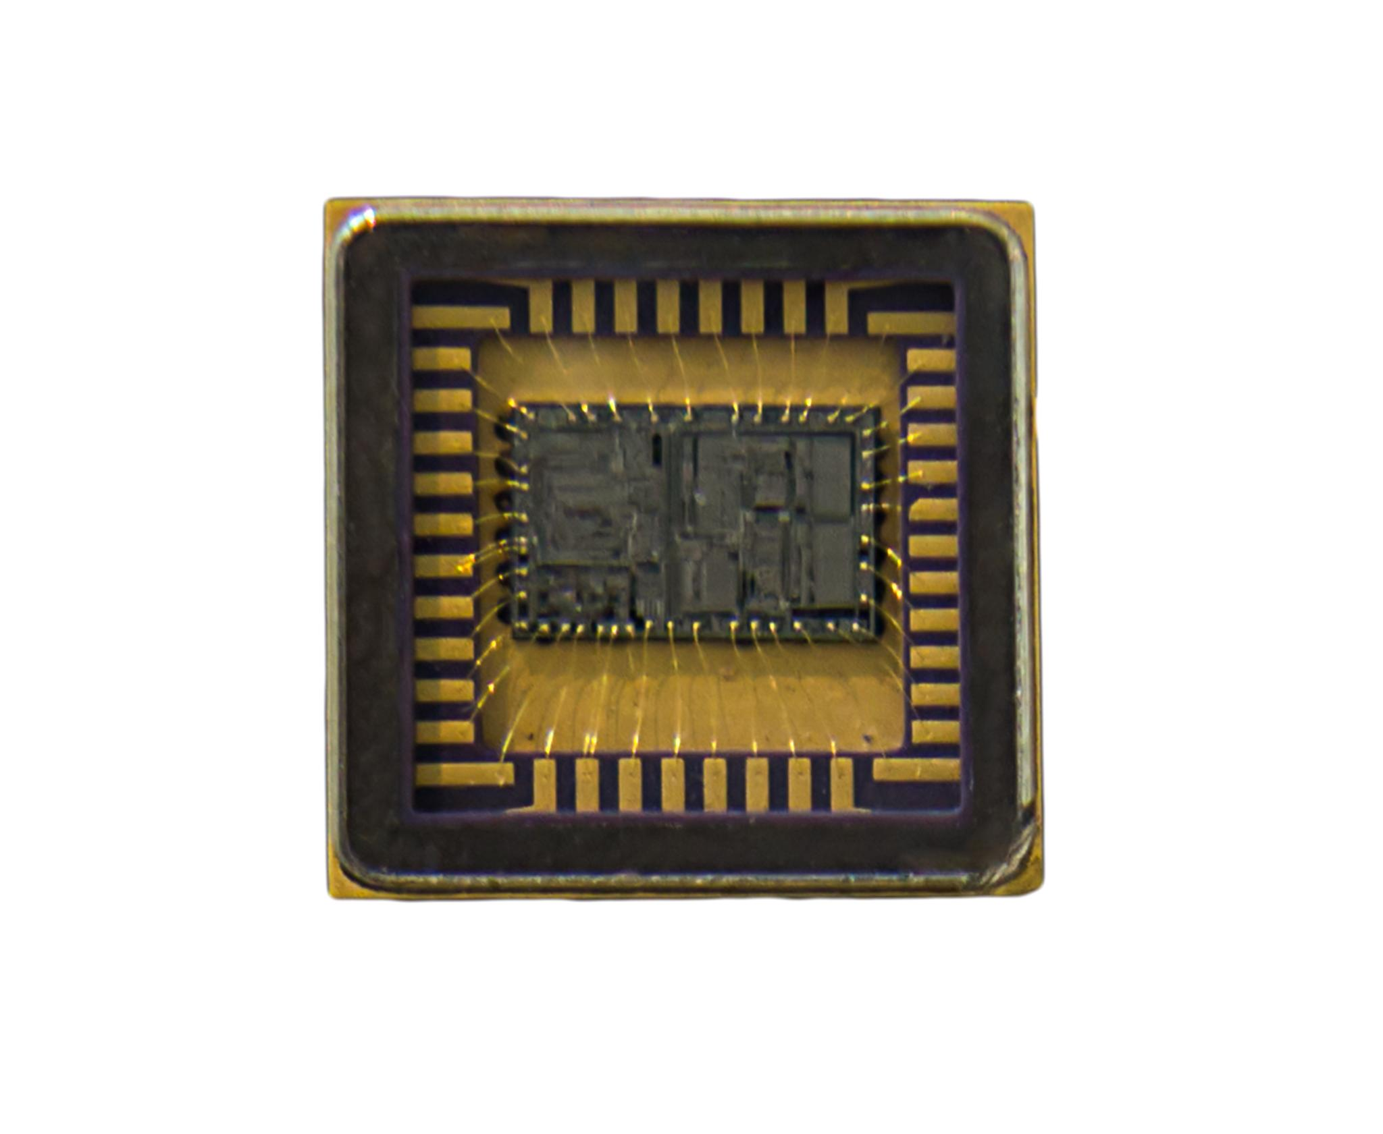
Prerequisites for Spark Installation
Java Compatibility
Ensure your system has a compatible version of Java installed, as it is essential for running Apache Spark.
System Resource Requirements
Verify that your system has adequate resources including memory and storage for optimal performance of Apache Spark.
Notes:
Before installing Apache Spark, ensure that your system meets the necessary prerequisites, including a compatible version of Java and adequate system resources for optimal performance.

Slide 25
Step-by-Step Installation Guide
Comprehensive Installation Steps
This guide outlines each step necessary for installing Apache Spark effectively, ensuring a successful setup.
Efficient Data Processing
Following the installation guide will enable you to start processing data efficiently with Apache Spark.
Smooth Setup Process
Adhering to the outlined steps will provide a smooth setup process, minimizing installation issues.
Notes:
This section provides a comprehensive installation guide for Apache Spark. Following these steps will ensure a smooth setup process, allowing you to start processing data efficiently.

Slide 26

Configuring and Running Spark Applications
Importance of Configuration
Proper configuration is essential for the successful execution of Spark applications, impacting performance and resource management.
Configuring Spark Settings
Learn how to adjust Spark settings to optimize performance based on your application needs and resources available.
Executing Spark Applications
Understand the process of running Spark applications effectively, ensuring smooth operation and efficient resource utilization.
Notes:
After installation, proper configuration is vital for running Spark applications. This slide will cover how to configure Spark settings and execute applications effectively.

Slide 27
Conclusion
Powerful Data Processing
Apache Spark stands out as a powerful tool for processing large volumes of data efficiently and effectively.
Speed and Flexibility
With its fast data processing capabilities, Spark provides flexibility in handling various data processing tasks across different platforms.
Informed Decision Making
Understanding Spark's architecture and benefits is crucial for organizations to make informed choices regarding their data strategies.
Notes:
In conclusion, Apache Spark is a powerful tool for big data processing, offering speed, flexibility, and ease of use. Understanding its fundamentals, architecture, and benefits can help organizations make informed decisions about data processing strategies.

